Slide 1
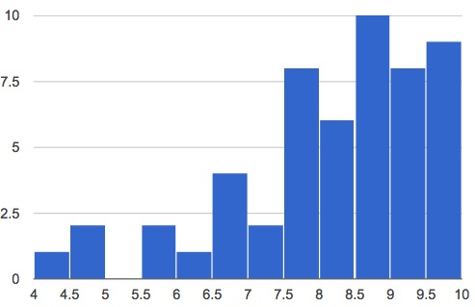

Slide 2
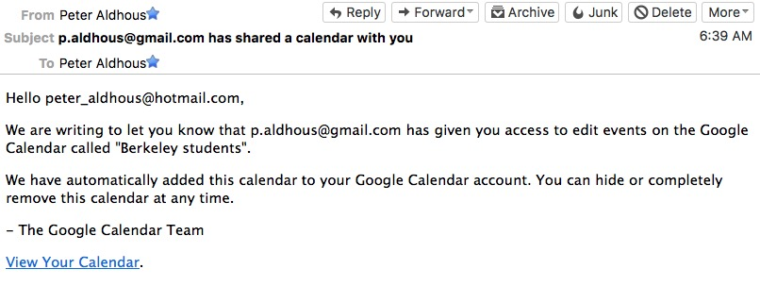

Slide 3
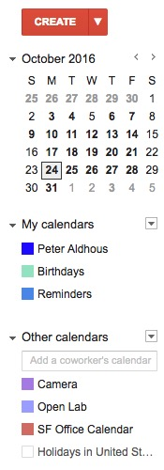

Slide 4
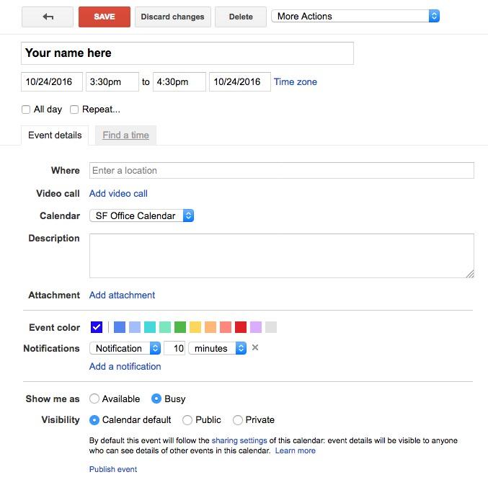

Slide 5
The basics
(OK, I have some data. What now?)
Sort
Largest to smallest; Alphabetical etc
Filter
Select a defined subset of the data
Summarize (Aggregate)
Count, Sum, Mean, Median, Maximum, Minimum etc
Join
Merge entries from two or more datasets based on common field(s), e.g. unique ID number, last name and first name
(Think of these operations as “interviewing” the data.)

